Slide 1

Getting Started with EMS Demo Provisioning
Introduction: Slides 2-4
Instructions for Microsoft Partner Users: Slides 5-10
Reference Info: Slides 12-13

Slide 2
What to expect from this guide
Setting up your Azure environment and EMS-enabled demo tenant is much more involved than a standard Office 365 tenant.
This guide will help you:
Perform the pre-requisite steps for creating your EMS tenant
Properly create and configure your Azure Subscription
Navigate the new Microsoft Demos portal (https://demos.Microsoft.com)
Properly leverage demo guides and other EMS resources
Introduction

Slide 3
What is Included with an EMS Tenant
Each EMS demo tenant provisioned will include:
An Office 365 “E5” environment, with trial license, and demo-ready sample content (document libraries, emails, OneDrive contents, Yammer posts, etc.)
A 100-user Azure AD with EMS trial license and key features pre-configured
An Intune environment pre-populated with apps, policies, and “fake” pre-enrolled devices
Azure Rights Management activated and pre-configured for key demo scenarios
Azure RemoteApp collection trial (expires in 30 days)
What to know going in:
The trial licenses of O365 and EMS in your tenant will expire in 90 days (~80 for a “Quick” tenant). Please see slide 20 for options for extending or re-provisioning your tenant.
These are demo trial tenants, to be used for demo purposes only. These tenants should not be handed to Customers or Prospects. Please visit the FastTrack program site on how you can provision PoC tenants that may be handed to Customers.
Introduction

Slide 4
How to Use Your EMS Tenant
Once you have a tenant, you will need to:
Reference/download the demo guides (available in the “Demos” tab of demos.microsoft.com portal) for detailed instructions. These include:
One-time manual setup for your tenant
Preparation of your demo devices
Perform pre-demo checklist steps listed at the beginning of each demo scenario.
Walk through your demo scenarios. Suggested scenarios are presented in the demo guides with detailed click steps and talking points.
Perform post-demo reset steps to ensure you’re able to repeat the demo scenario.
Introduction

Slide 5
Instructions for Microsoft Partner Users
Partner Instructions

Slide 6
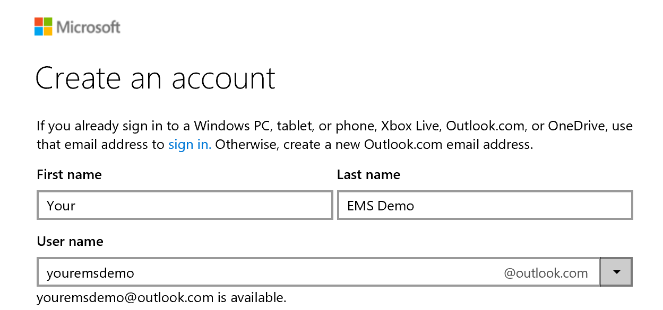
Step 1: Sign up for a NEW Demo Live ID Account
Working with a new Live ID will streamline both your EMS provisioning experience, and any demos that you conduct. We recommend you NOT use your everyday Live ID.
Go to https://signup.live.com.
Create a new account (e.g. youremsdemo@outlook.com).
Save login credentials for use later.
Partner Instructions

Slide 7
Step 2: Create a New Azure Subscription
Go to the Azure Account Management portal at https://account.windowsazure.com/
Log in with your work or Microsoft account (this is your Azure Account ID).
If no previous subscriptions exist:
Change URL to https://account.windowsazure.com/signup?offer=MS-AZR-0003P to sign up for a Pay-As-You-Go subscription
Complete the phone verification and payment info.
Accept Agreement, then Sign up.
If you have previous subscriptions: You may choose to use it for your Demo (proceed to next slide), OR create new:
Click Subscriptions
Click + add subscription
Select offer: Pay-As-You-Go
Verify Payment info and Agreement
Click Purchase.
NOTE: your credit card will NOT be charged for any services provisioned on your behalf.
Partner Instructions

Slide 8
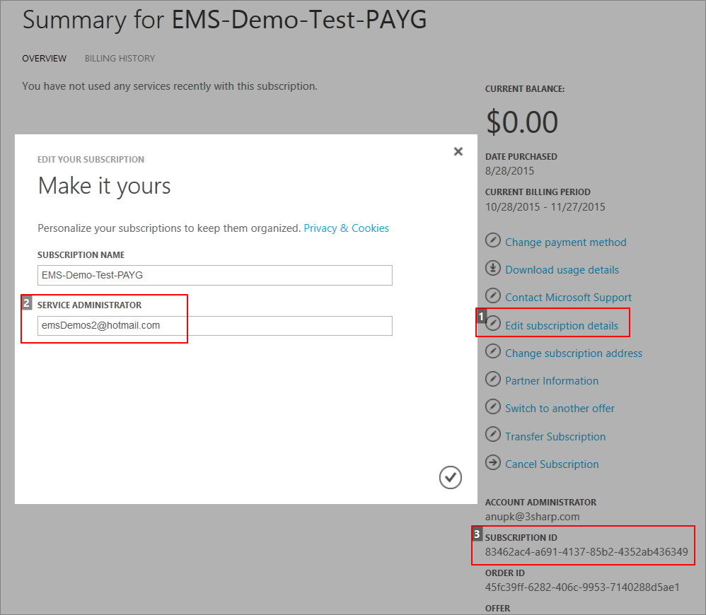
Step 3: Change Service Administrator to Live ID
Important: The Service Administrator of your Azure subscription must be changed to a Live ID/Microsoft Account for EMS demos to provision successfully.
Note: Granting your Live ID user Co-Administrators role is NOT sufficient – it must be granted Service Administrator.
Browse your list of Azure subscriptions, at https://account.windowsazure.com/subscriptions
Locate your Azure subscription and click for details.
Click Edit subscription details.
Change the Subscription Name.
Change Service Administrator to the Live ID you created in Step #1.
Click Save.
Copy the SUBSCRIPTION ID – you’ll need it later.
Partner Instructions

Slide 9
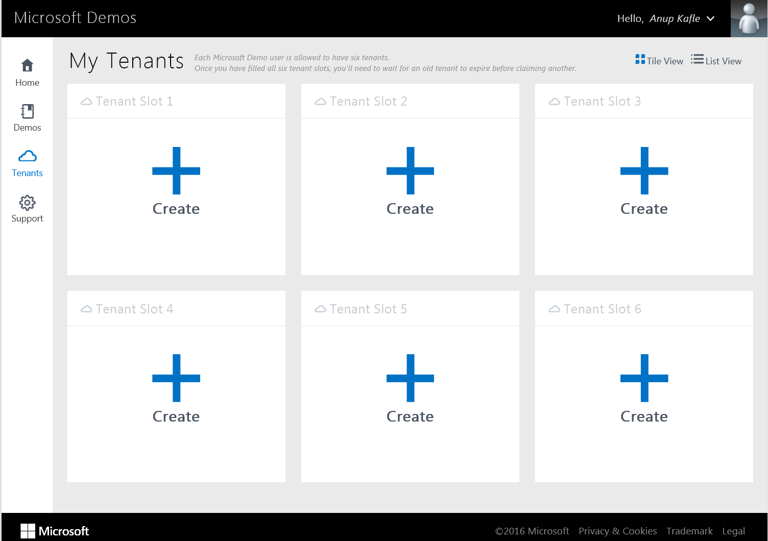
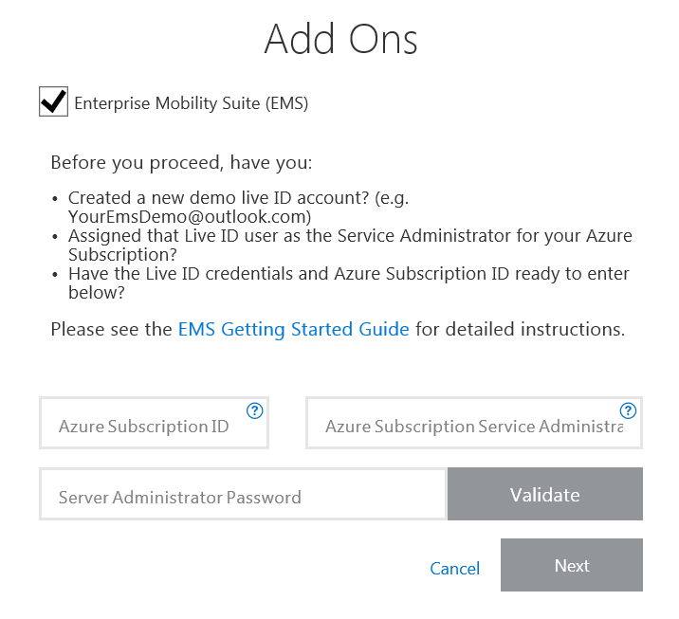
Step 4: Request your Quick Tenant with EMS Add-On
Go to http://demos.microsoft.com.
Log in as a Microsoft user (using your MSFT corporate AD credentials)
Go to Tenants tab.
Click + Create on one of six available “slots”.
Click Quick Tenant.
Select Standard Office 365 Content with options.
Check Enterprise Mobility Add On.
Enter in your Azure Subscription ID, Service Administrator user ID and password, then Validate.
Once your info has been validated, click Next.
Your tenant will be ready with EMS content in approx. 2 hours.
Partner Instructions

Slide 10
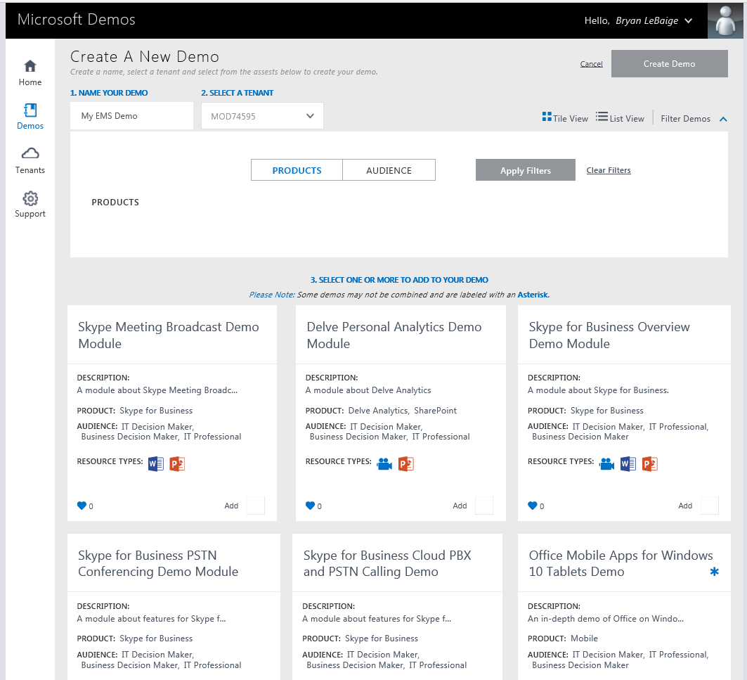
Step 5: Build your Demo
The Demos tab of the site allows you to build out your own demo guides by combining one or more published demo documents and videos.
Go to Demos.
Type a name for your demo (e.g. EMS Demos for Customer ABC)
Under Select a Tenant, select the demo tenant you just created.
Select one or more of the EMS demo modules that you would like to include:
Enterprise Mobility Hero Guide
Mobile Device and Application Development Guide
Identity and Access Management Guide
Information Protection Guide
Desktop Virtualization Guide
Partner Instructions

Slide 11
Reference Info

Slide 12
How to Extend or Retire Your Demo Environment
Once the trial licenses of O365 and EMS of your demo tenant expire, you have some options.
Convert trial O365 and EMS subscriptions to a paid subscription:
Login to your Tenant’s Office 365 Administration/Billing page (https://portal.office.com/Admin/Default.aspx#Billing)
Purchase license for 1 or 2 “hero” users in the Tenant (e.g. GarthF@, admin@)
Credit card info will be required
O365 E5 license cost: $35/user per month
EMS license cost: $8.35/user per month
You don’t have to purchase licenses for all users in the demo environment
Provision a new demo tenant using a NEW Azure Subscription:
Add a new Azure Subscription (IUR subscription or “Pay-as-you-Go” offer)
Follow steps provided in this guide to prep the subscription and provision your new Tenant
Provision a new demo tenant using the same Azure Subscription as before:
Go to the Tenant tab of demos.Microsoft.com portal and add a new tenant
Provide the same Azure subscription details as before
Note: Your new tenant will not be equipped with an Azure RemoteApp collection
Note: Your old tenant will not be accessible from Azure management portal
* Note: The Azure RemoteApp collection expires in 30-days from the provisioned date. To continue to demo Azure RemoteApp you will need to activate the RemoteApp service within your demo Azure subscription.
Reference

Slide 13
How to Get Help
Submit a Support/Help Ticket on the Microsoft Demos Portal site (http://demos.microsoft.com/support/dashboard)
Reference

